Slide 1


Box-Cox Transformations in High-Dimensional Linear Models William Ruth and Richard Lockhart
Notes:
HOW TO CHANGE IMAGE:
Click on image box.
Go to “Picture Format” tab
Click “Change Picture”
FONT: Impact, uppercase
Do not extend text outside of red section.
SUBHEADS / DAY MONTH YEAR:
Trebuchet MS, bold, uppercase

Slide 2
Outline
Riboflavin Data Example
Introduction
Box-Cox
LASSO
Box-Cox with LASSO
Residual Substitution
Penalized Likelihood

Slide 3
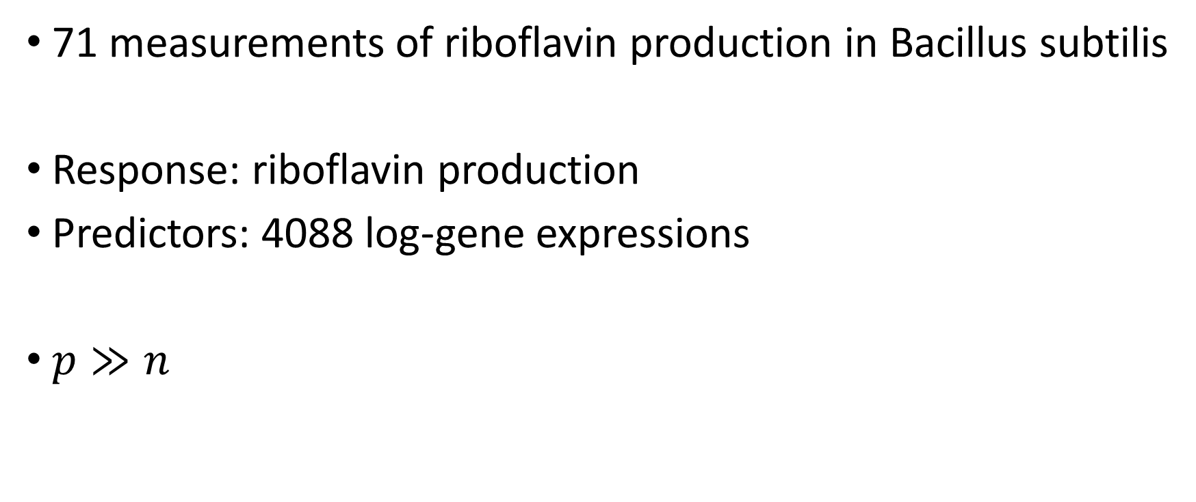
Riboflavin Data
71 measurements of riboflavin production in Bacillus subtilis
Response: riboflavin production
Predictors: 4088 log-gene expressions
$p≫n$

Slide 4

Riboflavin Data
Convention says to log $Y$
Comes this way in R
Is this transformation appropriate?
How would we check?

Slide 5

Riboflavin Data
If $p<n$, use Box-Cox
When $p>n$ always use LASSO
Why not both?

Slide 6

Box-Cox Framework
Usual regression model
$$Z=Xβ+σε$$
$$ε∼N\left(0,I\right)$$
Observe $X$ and $Y$, a transformation of $Z$
$$Y=h^{−1}(Z)$$

Slide 7
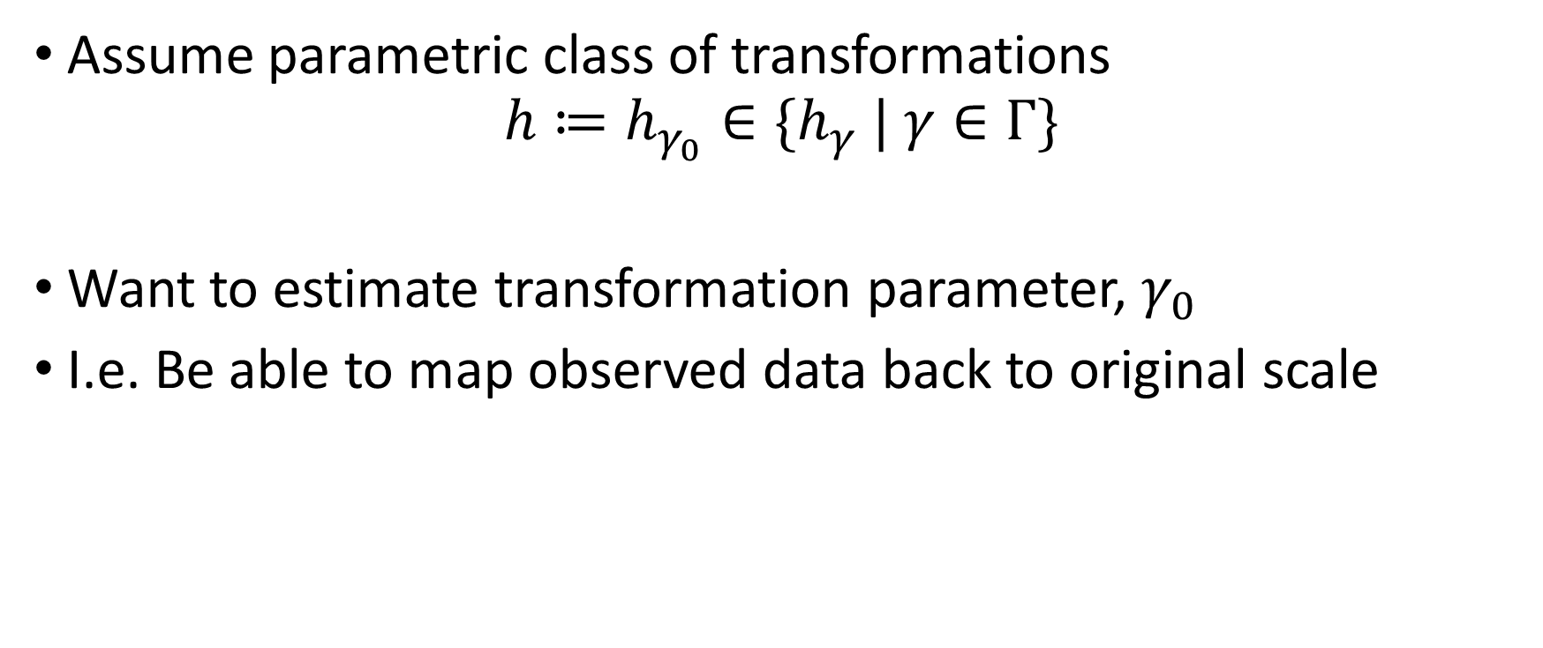
Box-Cox Framework
Assume parametric class of transformations
$$h≔h_{γ_{0}}∈\{h_{γ} | γ∈Γ\}$$
Want to estimate transformation parameter, $γ_{0}$
I.e. Be able to map observed data back to original scale
Notes:
$γ_{0}$ is often of interest both for statistical and scientific reasons

Slide 8

Box-Cox Framework
One popular class of transformations (Box and Cox, 1964):
$$h_{γ}\left(Y\right)= \left\{\begin{aligned}\frac{Y^{γ}−1}{γ} \text{if} γ≠0 \\ \log\left(Y\right) \text{if} γ=0\end{aligned}\right.$$

Slide 9

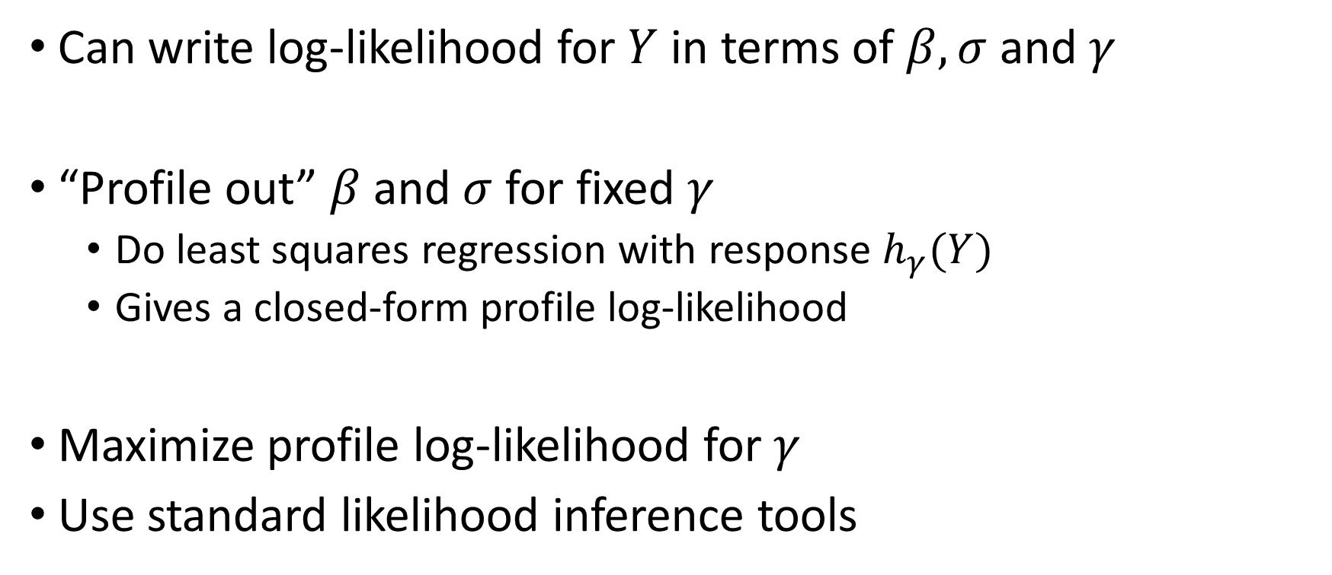
Estimating $γ$
Can write log-likelihood for $Y$ in terms of $β,σ$ and $γ$
“Profile out” $β$ and $σ$ for fixed $γ$
Do least squares regression with response $h_{γ}(Y)$
Gives a closed-form profile log-likelihood
Maximize profile log-likelihood for $γ$
Use standard likelihood inference tools
Notes:
Mention that “profile out” means “optimize over”

Slide 10
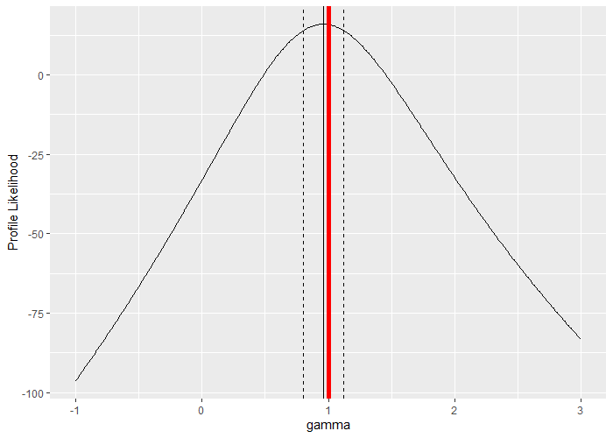
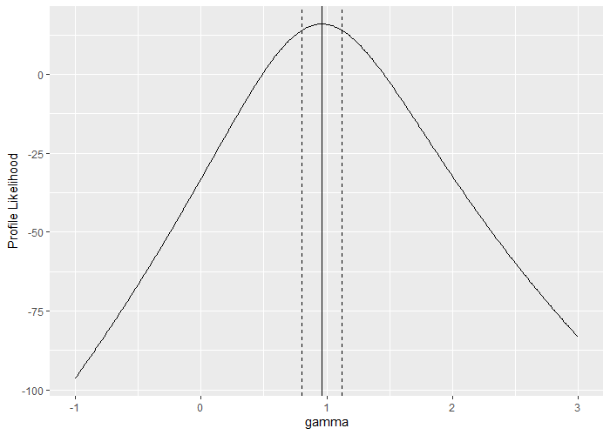
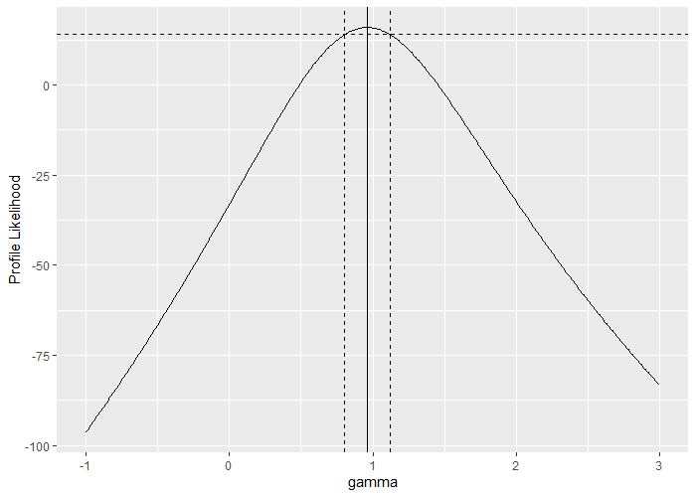
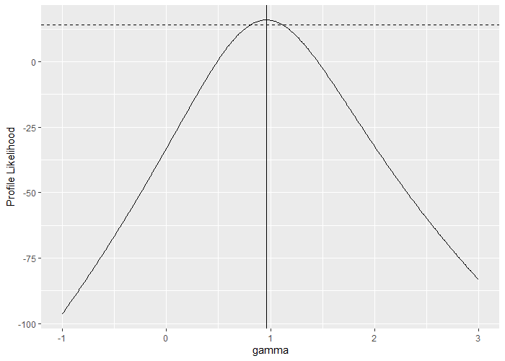


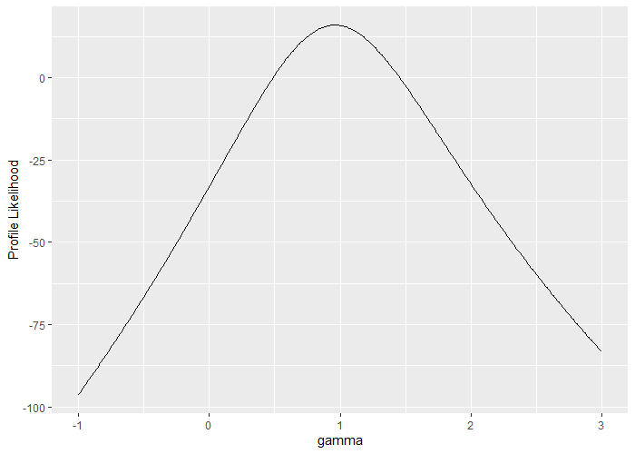
Estimating $γ$

Slide 11
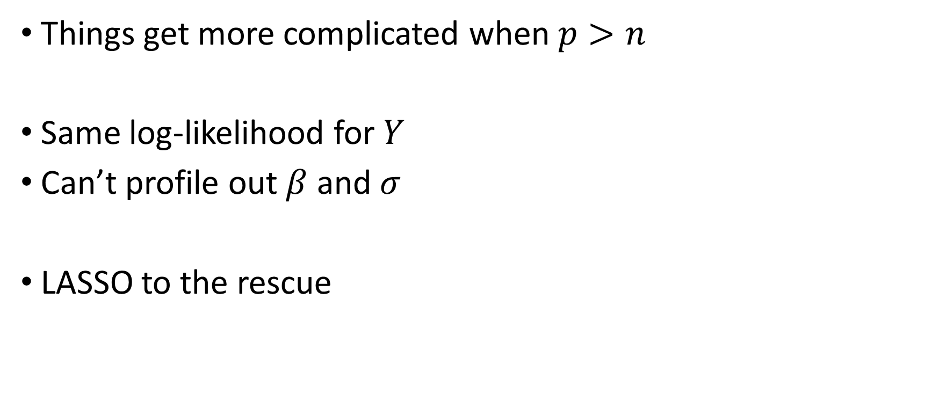
High Dimension
Things get more complicated when $p>n$
Same log-likelihood for $Y$
Can’t profile out $β$ and $σ$
LASSO to the rescue

Slide 12
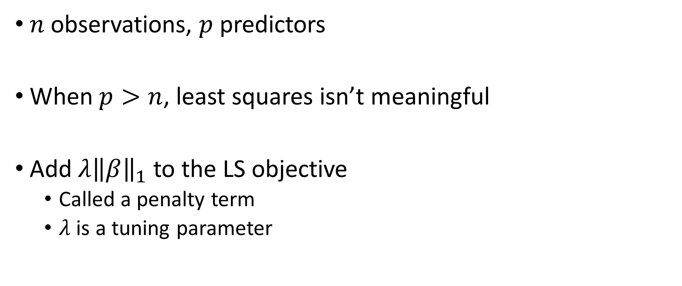
The LASSO
$n$ observations, $p$ predictors
When $p>n$, least squares isn’t meaningful
Add $λ{\left\|β\right\|}_{1}$ to the LS objective
Called a penalty term
$λ$ is a tuning parameter
Notes:
$λ$ chosen by CV 1SE throughout presentation

Slide 13
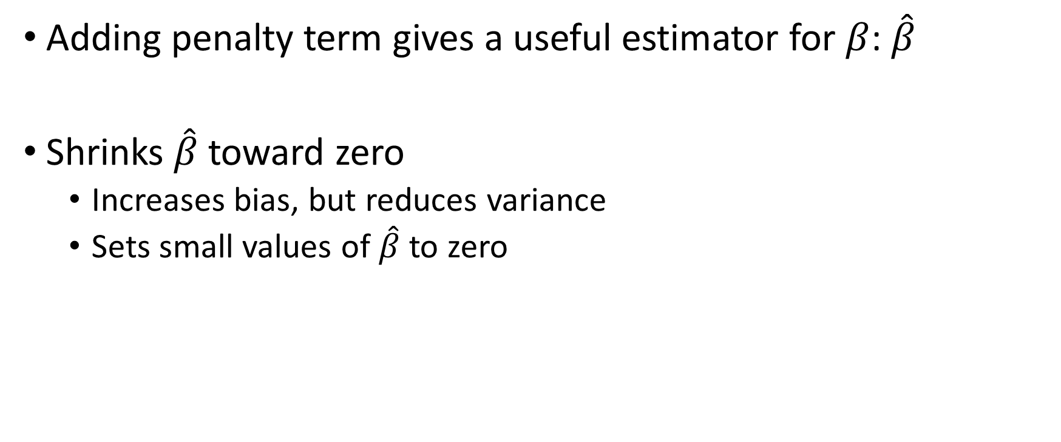
The LASSO
Adding penalty term gives a useful estimator for $β$: $\hat{β}$
Shrinks $\hat{β}$ toward zero
Increases bias, but reduces variance
Sets small values of $\hat{β}$ to zero

Slide 14
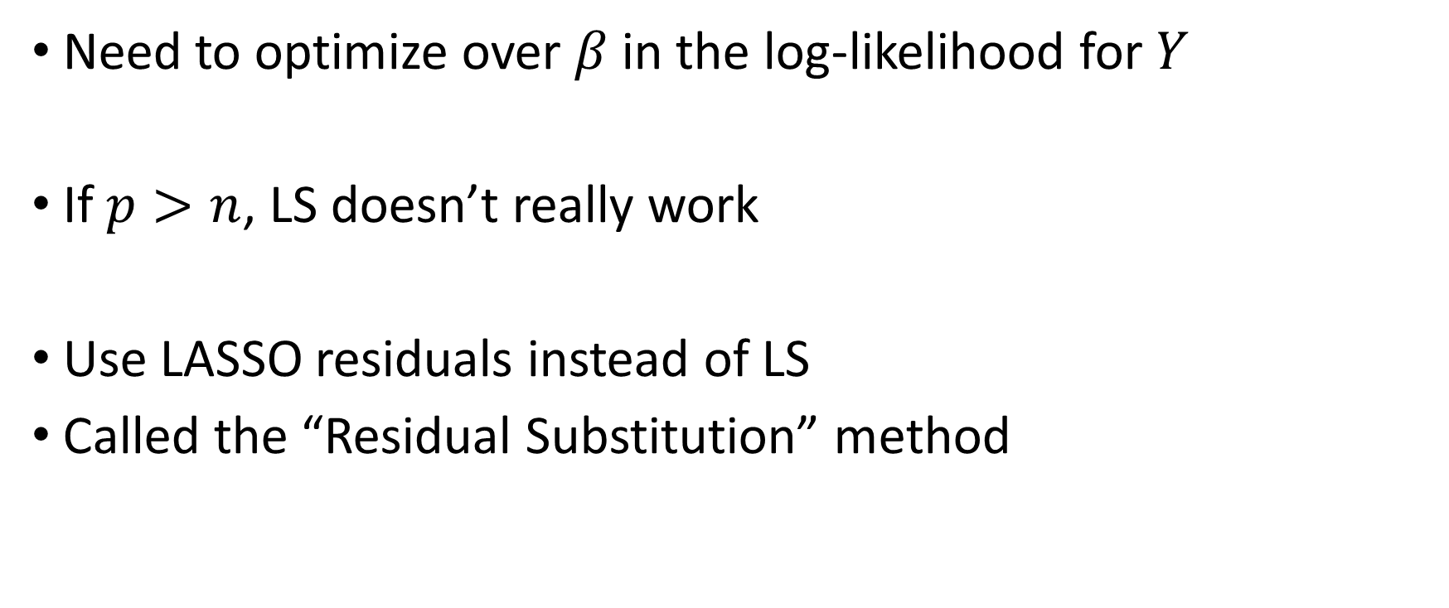
LASSO with Box-Cox
Need to optimize over $β$ in the log-likelihood for $Y$
If $p>n$, LS doesn’t really work
Use LASSO residuals instead of LS
Called the “Residual Substitution” method

Slide 15
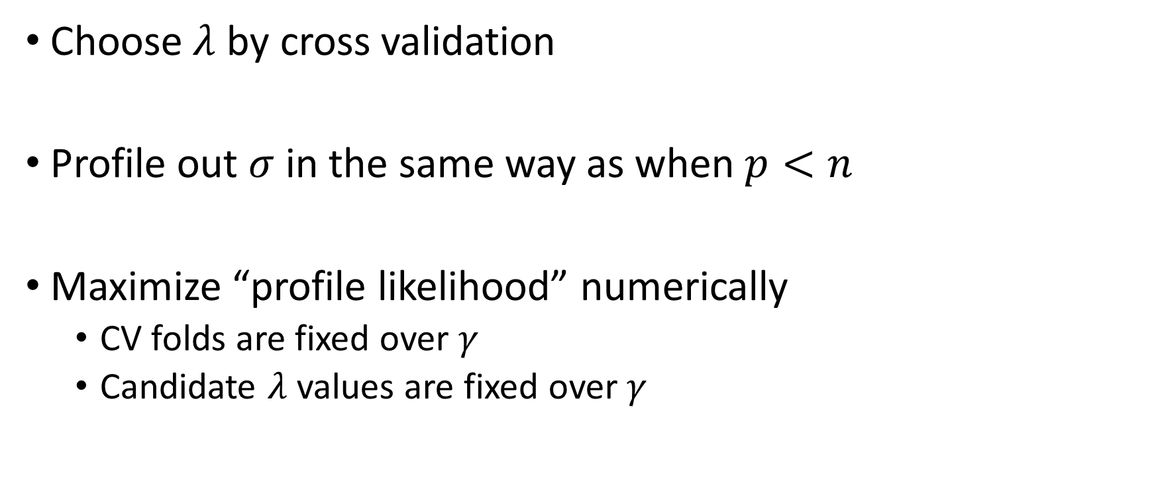
Residual Substitution
Choose $λ$ by cross validation
Profile out $σ$ in the same way as when $p<n$
Maximize “profile likelihood” numerically
CV folds are fixed over $γ$
Candidate $λ$ values are fixed over $γ$

Slide 16
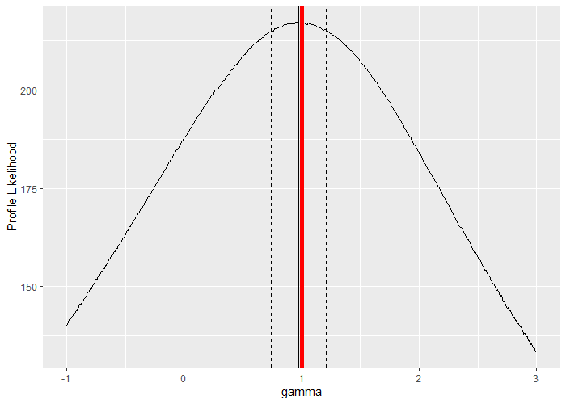
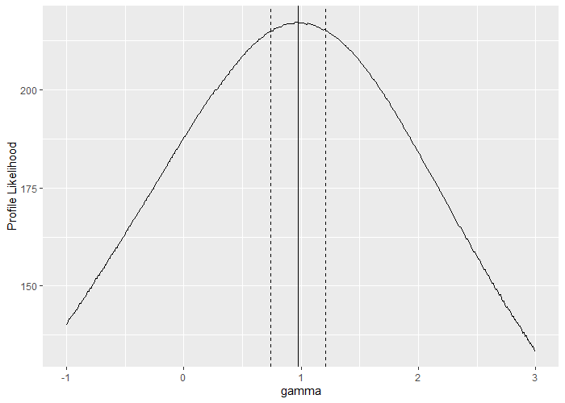
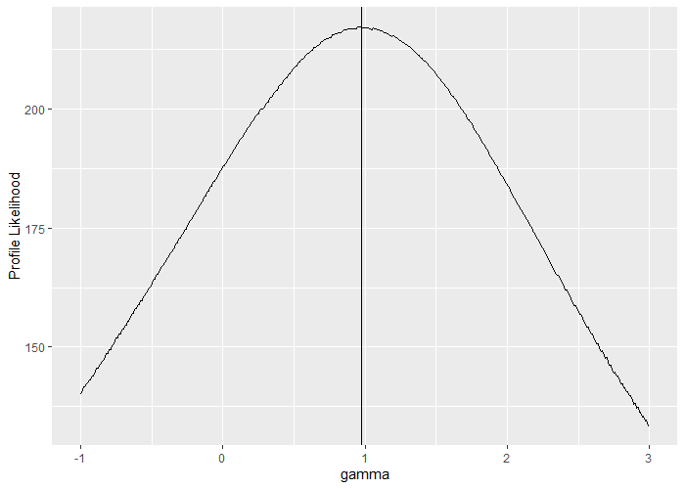


Residual Substitution

Slide 17

Riboflavin Data
Log-transform appropriate?
$p≫n$
Use residual substitution method

Slide 18
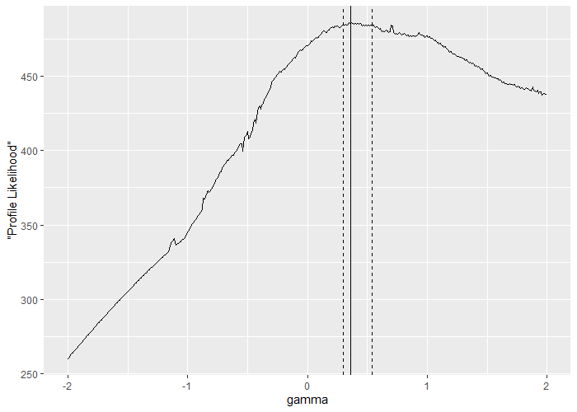
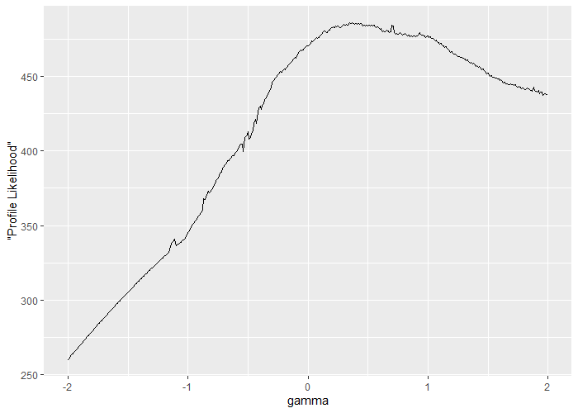
Riboflavin Data

Slide 19
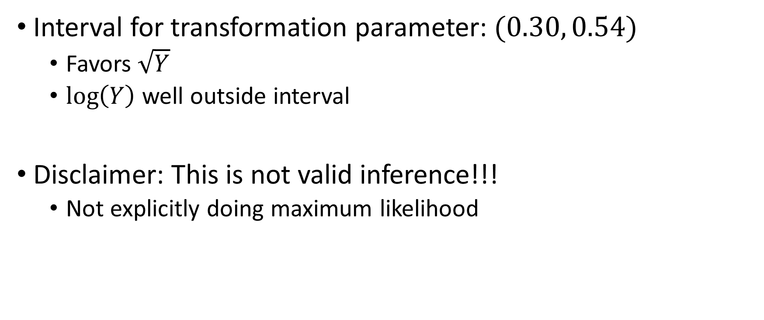
Riboflavin Data
Interval for transformation parameter: $(0.30, 0.54)$
Favors $\sqrt{Y}$
$\log\left(Y\right)$ well outside interval
Disclaimer: This is not valid inference!!!
Not explicitly doing maximum likelihood

Slide 20
Residual Substitution: Problem
The above approach is based on an analogy with LS:
Start with LS likelihood

Slide 21

Residual Substitution: Problem
LS profile likelihood
$$−\frac{n}{2}\log\left[∑{\left(h_{γ}\left(Y_{i}\right)−X{\hat{β}}_{LS}\right)}^{2}\right]+\left(γ−1\right)∑\log\left(Y_{i}\right)$$
Log-sum of squared
LS residuals
Jacobian of
Box-Cox
Transformation

Slide 22
Residual Substitution: Problem
The above approach is based on an analogy with LS:
Start with LS likelihood
Replace LS residual with LASSO residual

Slide 23

Residual Substitution: Problem
LASSO “profile likelihood”
$$−\frac{n}{2}\log\left[∑{\left(h_{γ}\left(Y_{i}\right)−X{\hat{β}}_{LASSO}\right)}^{2}\right]+\left(γ−1\right)∑\log\left(Y_{i}\right)$$
Log-sum of squared
LASSO residuals
Jacobian of
Box-Cox
Transformation

Slide 24
Residual Substitution: Problem
This gives an answer, BUT…
LASSO estimator not tied to the objective
Not clear how to do inference
Penalized likelihood method (Taylor and Tibshirani, 2018)

Slide 25
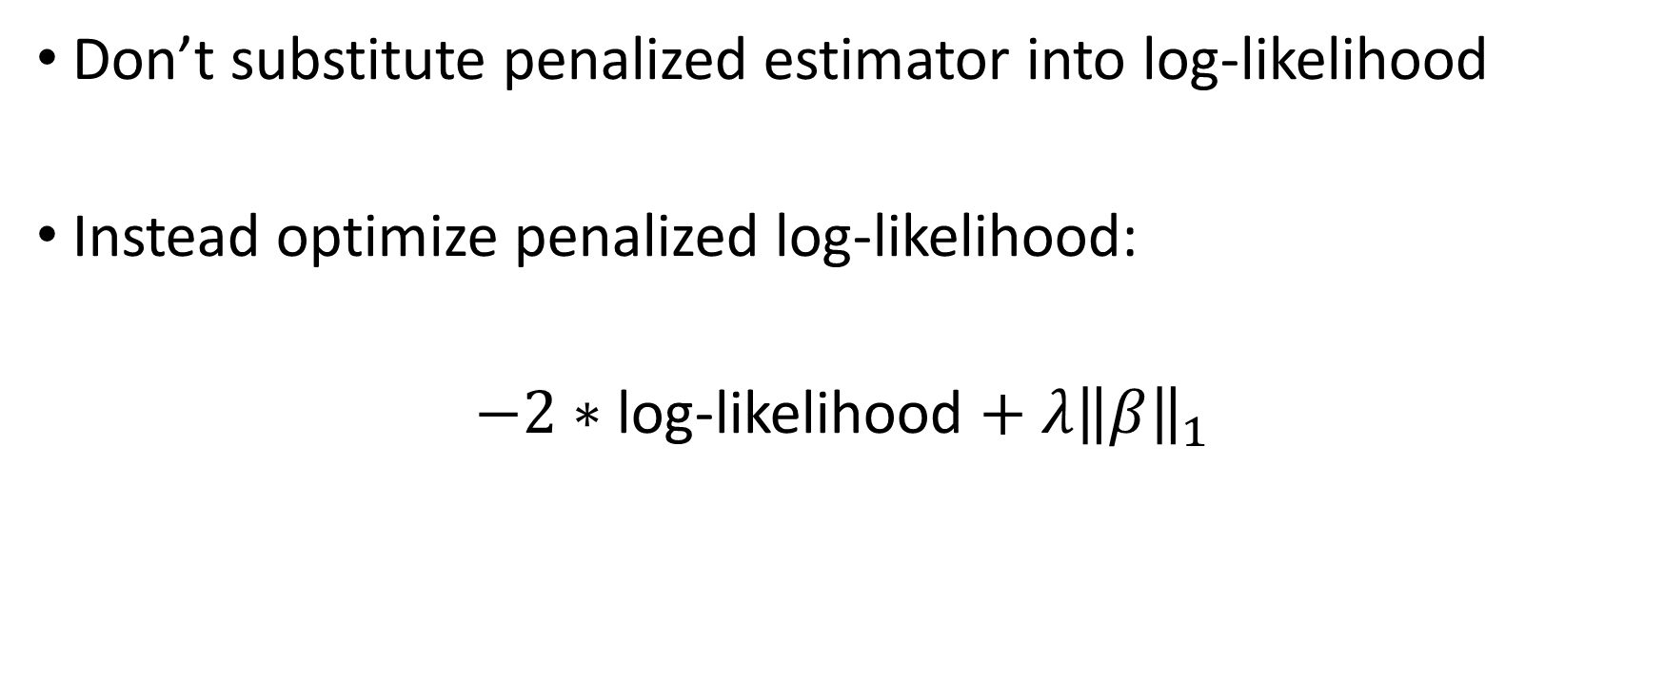
Penalized Likelihood
Don’t substitute penalized estimator into log-likelihood
Instead optimize penalized log-likelihood:
$−2∗$ log-likelihood $+$ $λ{\left\|β\right\|}_{1}$

Slide 26

Penalized Likelihood
After profiling, our objective is:
$$−\frac{n}{2}\log\left[∑{\left(h_{γ}\left(Y_{i}\right)−X\hat{β}\right)}^{2}+λ\left\|\hat{β}\right\|\right]+\left(γ−1\right)∑\log\left(Y_{i}\right)$$
Log of optimized
LASSO objective
Jacobian of
Box-Cox
Transformation

Slide 27
Penalized Likelihood
This new method is promising
Leverage inference tools from Taylor and Tibshirani
Under active development

Slide 28
Conclusion
Transformations relevant in high-dimensions
Box-Cox with high dimensional data
Residual substitution
Penalized likelihood

Slide 29
Thank You

